Slide 1
Tata Data Visualization
Presentation by NITHIN ANTHONY R

Slide 2
Tasks Done
1. Understood the business requirements and came up with 8 questions to the CEO and CMO
2. Based on their questions found the right Chart for Analysis
3. Cleaned the Data and Created a Dashboard in Tableau that answered all their Questions.
4. Created a power point presentation and a video to explain the Analysis.

Slide 3
Question 1 The CEO of the retail store is interested to view the time series of the revenue data for the year 2011 only. He would like to view granular data by looking into revenue for each month. The CEO is interested in viewing the seasonal trends and wants to dig deeper into why these trends occur. This analysis will be helpful for the CEO to forecast for the next year.
Question 2 The CMO is interested in viewing the top 10 countries which are generating the highest revenue. Additionally, the CMO is also interested in viewing the quantity sold along with the revenue generated. The CMO does not want to have the United Kingdom in this visual.
Question 3 The CMO of the online retail store wants to view the information on the top 10 customers by revenue. He is interested in a visual that shows the greatest revenue generating customer at the start and gradually declines to the lower revenue generating customers. The CMO wants to target the higher revenue generating customers and ensure that they remain satisfied with their products.
Question 4 The CEO is looking to gain insights on the demand for their products. He wants to look at all countries and see which regions have the greatest demand for their products. Once the CEO gets an idea of the regions that have high demand, he will initiate an expansion strategy which will allow the company to target these areas and generate more business from these regions. He wants to view the entire data on a single view without the need to scroll or hover over the data points to identify the demand. There is no need to show data for the United Kingdom as the CEO is more interested in viewing the countries that have expansion opportunities.

Slide 4
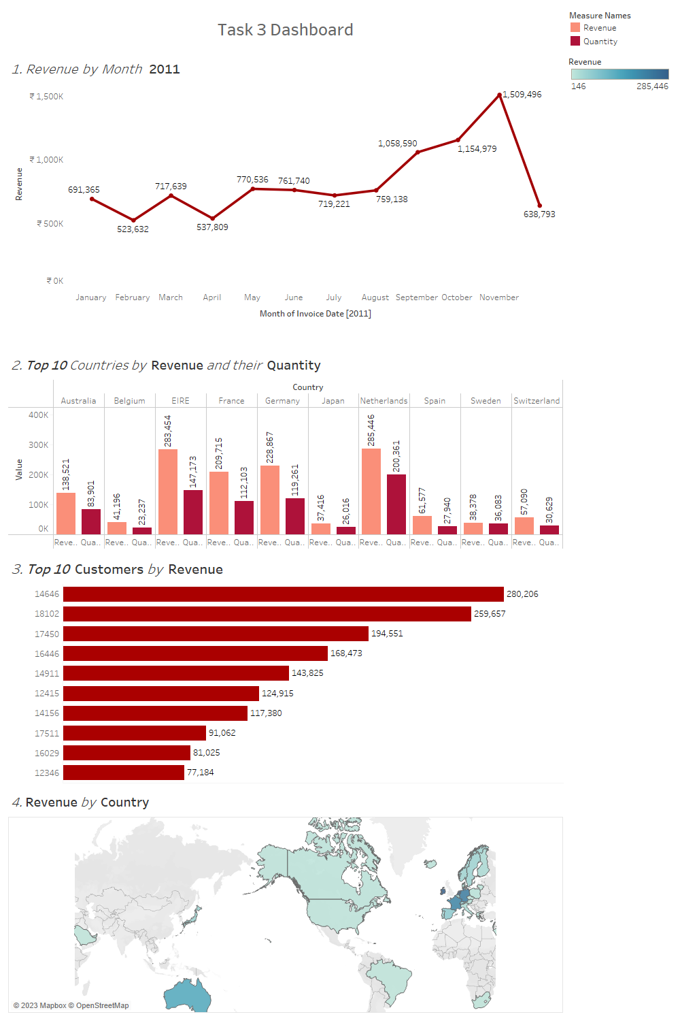
Over view of the dashboard

Slide 5
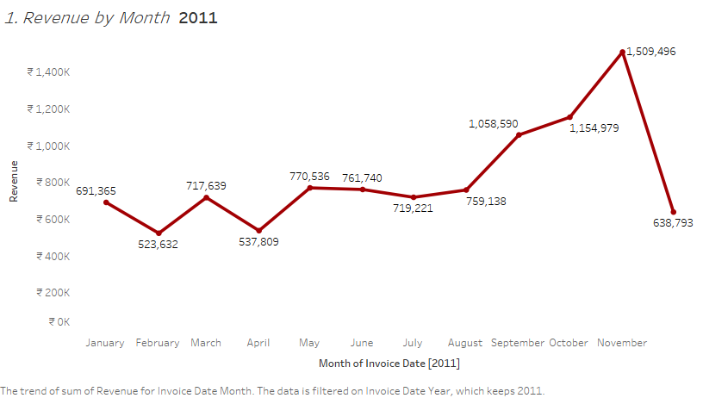

Slide 6
The first 8 months had a stable monthly revenue with an average of 6,85,000
There was a Significant increase between the Revenue and Quantity peaking at November with almost 15,00,000.
21.1 % increase in Revenue from August to November.
By Analyzing the Revenue trend especially from August to December we can conclude that seasonality has affected the retail store sales.

Slide 7
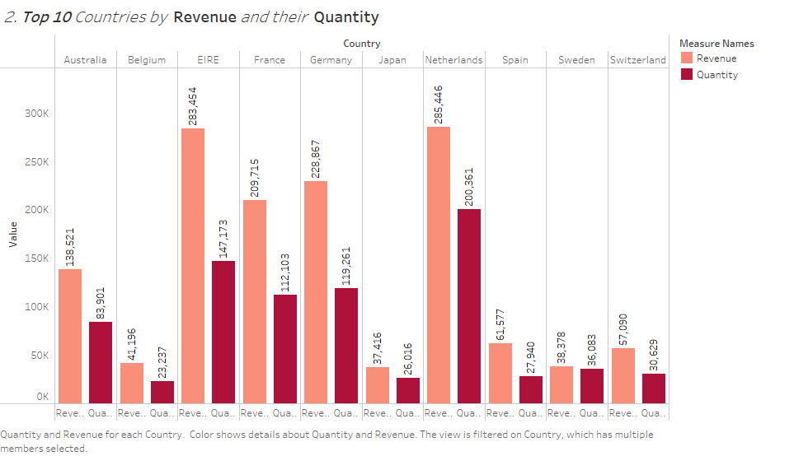

Slide 8
The chart represents all the Country except United kingdom
There is no major difference between the Revenue and the Quantity of goods that were sold in these countries.
The graph shows high Purchasing Power in these Countries
These are the countries that represent high potential to generate high revenue. Management should have these Countries as the priority after UK.

Slide 9
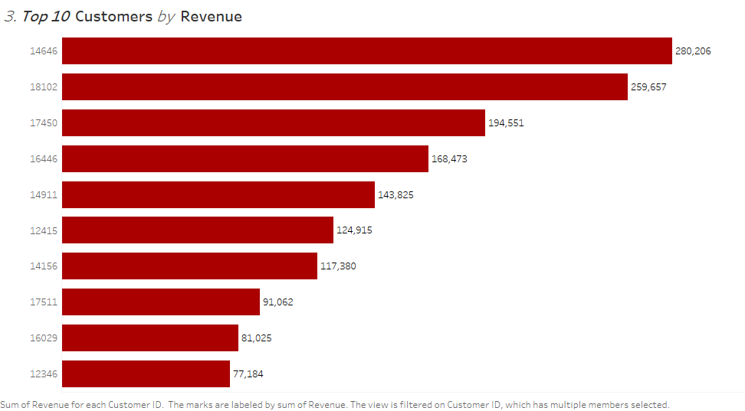

Slide 10
From the chart we can see that there is no major difference between the top 10 Customers in terms of revenue generated.
Average difference in revenue between top 10 customers is 15.8 %
The company can aim to strengthen relationship with these customers to increase their loyalty and retention, this can drive more sales and revenue for the company.

Slide 11
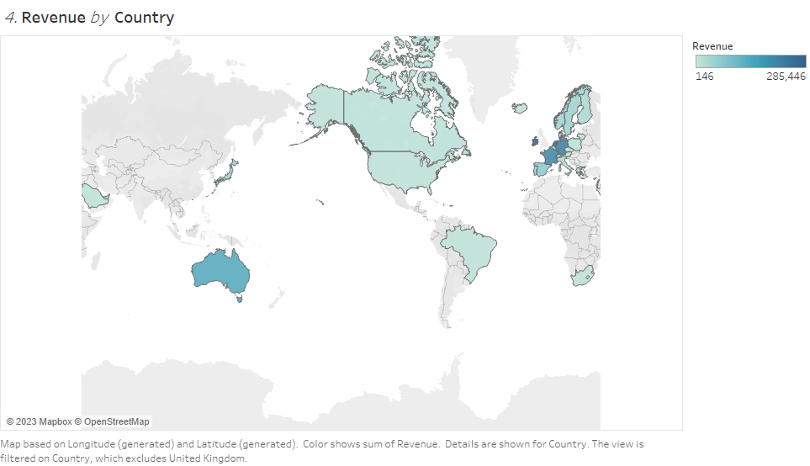

Slide 12
The map chart concludes by comparing the places that have produced the greatest revenue to those that have not.
The map also reveals that the majority of sales occur only in the European zone, with only a small number in the American region Along with Russia, there is no market for the same in Africa or Asia
The company can concentrate on the European market and establish new stores in Asia and Africa
The company can also come up with strategies that will maximize sales from each country in the region alongside Australia and Japan

Slide 13
Conclusion
The company should come up with strategies that aim at stocking and advertising seasonal products to maximize sales when the demand for these goods goes up
The company should do a deeper analysis of products that are usually in high demand during low-sales months to come up with strategies for marketing these products.
A deeper dive into the type of products and the revenue generated from these products for each region would be key in guiding region-specific marketing strategies.
The company should consider incentivizing top revenue-generating customers to strengthen the relationship with these customers.
The European Market has more potential for growth and the company should aim at strategies that will increase its market positioning in the region.

Slide 14
THANK YOU

